Slide 1



IBM Blockchain Platform Explored
A Technical Deep-Dive on IBM Blockchain Platform SaaS
Blockchain Explored Series
IBM Blockchain Platform Explored
Architectures Explored
Fabric Explored
Composer Explored
What’s New
V1.0, 5th December 2018
Notes:
This is the technical deep dive on Hyperledger Fabric. Presentations in this series are:
Blockchain Explained: High level introduction to blockchain for business
Blockchain Solutions: Use-cases, references and how IBM can help
Blockchain Composed: A technical introduction to Hyperledger Composer
Blockchain Architected: A technical introduction to the concepts and components of a blockchain solution
Blockchain Explored: A technical deep dive on Hyperledger Fabric
Blockchain Next Steps: How to proceed on a first project
The latest copy of this presentation can be found on the IBM intranet at https://ibm.box.com/v/BlockchainExplored. Feel free to distribute a PDF of this file to clients.

Slide 2

Technical Deep Dive
[ Roadmap ]
Architectural Overview
Platform Components
Organization and Plans
Transaction Flow
Example Networks
Network Setup
Endorsement Policies
Identities and MSP

Slide 3
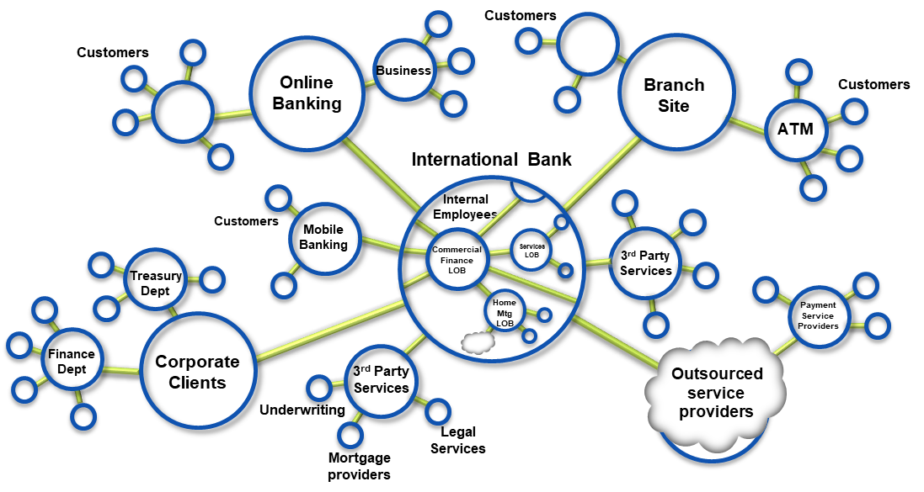
Blockchain Recap
Blockchain builds on basic business concepts
Business Networks connect businesses
Participants with Identity
Assets flow over business networks
Transactions describe asset exchange
Contracts underpin transactions
The ledger is a log of transactions
Blockchain is a shared, replicated, permissioned ledger
Consensus, provenance, immutability, finality

Slide 4
Roadmap
v2.0
v1.1
Local collections
SDK improvements
Lifecycle changes
Revocation for Idemixer
Tokenisation
RAFT
Javascript chaincode
Connection profile
Encryption library
Attribute access control
CouchDB indexes
Channel based events
v1.3
State based endorsement
Java chaincode
CouchDB pagination
Identity Mixer
07/17
03/18
06/18
10/18
4Q/18
*
1Q/19
*
Channels
Selective endorsement
SOLO/Kafka orderers
LevelDB or CouchDB
ACLs
Service discovery
Pluggable endorsement and validation
Private Data Collections
Operational metrics and logging
SDK and SHIM improvements
Burrow EVM
Long Term Service (LTS) support
v1
v1.2
v1.4
Based on https://wiki.hyperledger.org/projects/fabric/roadmap - Dates determined by the Hyperledger community - (*) Subject to change
Notes:
Useful links for more information:
What’s New (for more details on roadmap features): https://ibm.box.com/v/BlockchainWhatsNew
Hyperledger Fabric Roadmap: https://wiki.hyperledger.org/projects/fabric/roadmap
List of release notes: https://github.com/hyperledger/fabric#releases
Release notes:
V1.0 GA: https://github.com/hyperledger/fabric/releases/tag/v1.0.0
V1.1: https://github.com/hyperledger/fabric/releases/tag/v1.1.0
V1.1-preview: https://github.com/hyperledger/fabric/releases/tag/v1.1.0-preview
V1.1-alpha: https://github.com/hyperledger/fabric/releases/tag/v1.1.0-alpha
V1.2: https://github.com/hyperledger/fabric/releases/tag/v1.2.0
V1.3: https://github.com/hyperledger/fabric/releases/tag/v1.3.0
Release planning:
V1.1: https://wiki.hyperledger.org/projects/fabric/proposedv1_1
V1.2: https://docs.google.com/document/d/1prtMkLOkZZx7RYi_meb-3yY6lgFhISLQtx8AcSMDhdo/edit
V1.3: https://jira.hyperledger.org/browse/FABN-692?jql=issuetype%20%3D%20Epic%20AND%20fixVersion%20%3D%20v1.3.0
V1.4: https://jira.hyperledger.org/browse/FABN-895?jql=issuetype%20%3D%20Epic%20AND%20fixVersion%20%3D%20v1.4.0
Originally based on: https://jira.hyperledger.org/browse/FAB-37 also

Slide 5
Roadmap
IBM Blockchain Platform
Starter Plan announced
Starter Plan GA
Starter Plan v1.2.1
Entry level developer blockchain environment
Simple one-click provision and easy simulation of a multi-org environment
Same look and feel as Enterprise Plan
Based on Fabric v1.1
Available in many data centres
Free 30 day trial
Provisioned using IBM Containers
Updated to Fabric v1.2.1
08/17
02/18
05/18
06/18
10/18
10/18
Fully managed enterprise grade blockchain-as-a-service
Built on Fabric 1.0
Built on LinuxONE
New networks provisioned with Fabric v1.1
Additional data centre locations
On-prem peer solution
Built on Fabric v1.2.1
Provisioned using IBM Cloud Private
Enterprise Plan GA
Enterprise Plan v1.1
Remote Peer
Beta announcment
Notes:
Useful links for more information:
What’s New (for more details on roadmap features): https://ibm.box.com/v/BlockchainWhatsNew
Hyperledger Fabric Roadmap: https://wiki.hyperledger.org/projects/fabric/roadmap
List of release notes: https://github.com/hyperledger/fabric#releases
Release notes:
V1.0 GA: https://github.com/hyperledger/fabric/releases/tag/v1.0.0
V1.1: https://github.com/hyperledger/fabric/releases/tag/v1.1.0
V1.1-preview: https://github.com/hyperledger/fabric/releases/tag/v1.1.0-preview
V1.1-alpha: https://github.com/hyperledger/fabric/releases/tag/v1.1.0-alpha
V1.2: https://github.com/hyperledger/fabric/releases/tag/v1.2.0
V1.3: https://github.com/hyperledger/fabric/releases/tag/v1.3.0
Release planning:
V1.1: https://wiki.hyperledger.org/projects/fabric/proposedv1_1
V1.2: https://docs.google.com/document/d/1prtMkLOkZZx7RYi_meb-3yY6lgFhISLQtx8AcSMDhdo/edit
V1.3: https://jira.hyperledger.org/browse/FABN-692?jql=issuetype%20%3D%20Epic%20AND%20fixVersion%20%3D%20v1.3.0
V1.4: https://jira.hyperledger.org/browse/FABN-895?jql=issuetype%20%3D%20Epic%20AND%20fixVersion%20%3D%20v1.4.0
Originally based on: https://jira.hyperledger.org/browse/FAB-37 also

Slide 6
Technical Deep Dive
Roadmap
[ Architectural Overview ]
Platform Components
Organization and Plans
Transaction Flow
Example Networks
Network Setup
Endorsement Policies
Identities and MSP

Slide 7



Platform Architecture Overview
External-CA
Fabric-CA
CA
Membership
Services
optional
CA
optional
Admin
IBP UI
Peer
Endorser
Application
SDK
Committer
O
Ledger
Hardware Security Module(*)
Users
Chaincode
A
B
O
O
Events
!
Ordering-Service
IBM Blockchain Platform
(*) Enterprise Plan

Slide 8
How applications interact with the IBM Blockchain Platform
Develops
Application
Blockchain
Developer
SDK
Submits
Chaincode
Accesses
Emits
!
Get, Put, Delete
Record
0
1
2
3
Emits
!
Blockchain
WorldState
Ledger
Peer
IBM Blockchain Platform
Notes:
A developer will create an application and smart contract (could be different developers)
The application will invoke calls within the smart contract via an SDK
Those calls are processed by the business logic within the smart contract
- a ‘put’ or ‘delete’ command will go through consensus protocol selected and added to the blockchain
- a ’get’ command can only read from the world state but is not recorded on the blockchain
An application can access Block information via rest APIs such as get block height
Note the use of ‘Delete’ here – delete can delete keys from the world state database, but not transactions from the blockchain, which we’ve established is immutable.

Slide 9
Technical Deep Dive
Roadmap
Architectural Overview
[ Platform Components ]
Organization and Plans
Transaction Flow
Example Networks
Network Setup
Endorsement Policies
Identities and MSP

Slide 10
IBM Blockchain Platform - Peer
A
With the IBM Blockchain Platform each peer:
Connects to one or more channels
Maintains one ledger per channel
Maintains installed chaincode
Manages runtime docker containers for instantiated chaincode
Chaincode is instantiated on a channel
Runtime docker container shared by channels with same chaincode instantiated (no state stored in container)
Has a local MSP (Membership Services Provider) that provides crypto material
Emits events to the client application
Peer
Chaincode
Channels
B
Events
!
Local
MSP
0
1
2
3
Ledger
Blockchain
WorldState

Slide 11
IBM Blockchain Platform - Ledger
The ledger is maintained by each peer and includes the blockchain and worldstate
A separate ledger is maintained for each channel the peer joins
Transaction read/write sets are written to the blockchain
Channel configurations are also written to the blockchain
The worldstate can be either LevelDB (default) or CouchDB
LevelDB is a simple key/value store
CouchDB is a document store that allows complex queries
The smart contact decides what is written to the worldstate
Config Block
0
Config
Block
1
Transaction
Block
2
Transaction
Block
3
Worldstate
Genesis
Blockchain

Slide 12
Summary of a Block
This is a summary of a block stored within an IBM Blockchain Platform ledger
Header |  |  | Number | Previous hash (merkel root) |  | Data hash (merkel root)
Block Data (repeated per transaction) | Signature |  | Client signature of transaction payload
 | Payload | Header | Channel Header (timestamp, tx_id, type, …) |  | Signature Header (client certificate) | Signature Header (creator certificate)
 |  | Data | Client certificate |  | MspId
 |  |  | Proposal payload |  | Proposal hash
 |  |  | Array of keys read (key and version of value)
 |  |  | Array of keys written (key/value and delete flag)
 |  |  | Array of range_queries (start/end key and list)
 |  |  | Events (chaincode_id, tx_id, name, payload)
 |  |  | Chaincode response (status, message, payload)
 |  |  | Chaincode ID (path, name, version)
 |  |  | Array of endorsers (mspid, certificate, signature)
Block Metadata |  |  | Array of orderers (mspid, certificate, signature)
 |  |  | Array of transaction valid flags
Block
Index
Data

Slide 13
Description of Block Fields
Proposal payload : These are the transaction input arguments.
Client certificate: Certificate and signature of client application that invoked the transaction.
Array of keys read: The key and latest version of the value read from the world state.
Array of keys written: The key and value written to the world state
Array of Endorsers: Certificates and signatures from Endorsers of transaction.
Events: Events emitted from chaincode.
Chaincode response: Any response from invoking the chaincode.

Slide 14
IBM Blockchain Platform - Client Application
Each client application uses the Fabric SDK to:
Connect over channels to peers
Connects over channels to orderer nodes
Receives events from peers
Access a local MSP that provides client crypto material
Client can be written in different languages (Node.js, Go, Java, Python)
Channels
Application
SDK
!
Events
Local
MSP

Slide 15

IBM Blockchain Platform - Certificate Authority (CA)
Certificate Authority within each organisation for issuing certificates for administrators and users
Enterprise plan includes a clustered CA for HA characteristics
Enterprise plan includes an HSM for security
Can be configured as an intermediate CA for remote issuance of administrator and user certificates
CA
HSM
DB
Root
Certificate Authority
High Availability
Secure

Slide 16
IBM Blockchain Platform - Ordering Service
The ordering service packages transactions into blocks to be delivered to peers. Communication with the service is via channels.
The types of ordering service are:
SOLO
Single node for development in Starter Plan
Kafka : Crash Fault Tolerant service in Enterprise Plan
3 nodes
Uses Kafka and ZooKeeper technologies
O
O
O
Ordering-Service
Notes:
Based on kafka (https://kafka.apache.org).
3 initial consensus protocols expected:
SOLO - single node, maybe running on z or whatever but usually for development. Like No-ops but single node and proper consensus.
Kafka – ordering nodes need to be trusted for confidentiality, ordering-service must not leak across channels. Peers not trusted. Access control on the channel. The ordering-service sees the transactions, unless encrypted by the chaincode. Crash fault tolerant.
Simple BFT (SBFT) - complete code rewrite over v0.6. 97% PBFT. This model can cope with ordering nodes attempting to corrupt data. Need to resort to crypto at the chaincode level in v1, but in the future this will be provided in the fabric. Will include non-deterministic checking of chaincode output. Single channel (see later) supported for V1.

Slide 17
IBM Blockchain Platform - Channels
Channels provide privacy between different ledgers
Ledgers exist in the scope of a channel
Channels can be shared across an entire network of peers
Channels can be permissioned for a specific set of participants
Chaincode is installed on peers to access the worldstate
Chaincode is instantiated on specific channels
Peers can join multiple channels
Concurrent execution for performance and scalability
E₀
O
O
O
E₁
Ordering-Service
Notes:
Partitioning for privacy makes sense only with non-BFT ordering-services. BFT ordering-services validate transactions across all validation nodes.
Channels do not need to be connected to by all nodes
Peers are permissioned to connect to a channel via an access control policy
Transactions broadcast to a channel are ordered by the ordering-service.
All peers receive transactions in exactly the same order for a channel.
Transactions are delivered in cryptographically linked blocks.
Each peer validates the delivered blocks and commits them to the ledger.

Slide 18
Technical Deep Dive
Roadmap
Architectural Overview
Platform Components
[ Organization and Plans ]
Transaction Flow
Example Networks
Network Setup
Endorsement Policies
Identities and MSP

Slide 19
IBM Blockchain Plans
Starter Plan
An entry level option that enables organizations to simulate multi-organization blockchain networks, quickly develop applications, and work with sample smart contracts and business networks.
Enterprise Plan
A production-ready offering for organizations who would like to create or join a blockchain network for real businesses. This plan provides the key infrastructure along with tools and support to easily start a highly secure and production-ready network.

Slide 20
Organisations
Each member organisation defines boundaries within the network
An organisation is created within the scope of an IBM Cloud Account
An IBM Cloud Account can create multiple organisations on its behalf
Each organisation includes:
Membership Services Provider (MSP) for identities
Administrator(s)
Users
Peers
Fabric-CAs
A network includes many organisations representing a consortium
Each organisation has an ID
User
Admin
E
CA
E
CA
MSP
Peer
ID = Org1
IBM Cloud Account

Slide 21
Initial Starter Plan Network
The initial setup for a starter plan network which is intended for development purposes
CA
E
Plan | Starter
Ordering Service | Solo (1 orderer)
Initial # of orgs | 3
Max # of orgs | Unlimited*
Initial peers per org | 1
Max peers per org | Unlimited
CPU per peer | 1
RAM per peer | 2GB
CA nodes per org | 1
Max Storage | 20GB (network)
Max # of channels | 150
Max # of instantiations | 10
A
B
Org1
O
CA
E
A
B
Org2
OrdererOrg
Initiator
IBM
Network
(*) Additional orgs and peers within initiator’s cloud membership

Slide 22
Initial Enterprise Plan Network
The initial setup for an enterprise plan network which is intended for UAT, ST and Production purposes
CA
Plan | Enterprise
Ordering Service | CFT (*)
Initial # of orgs | 2
Max # of orgs | 15
Initial peers per org | 1
Max peers per org | 6
CPU per peer | 1 vCPU (small)
RAM per peer | 2GB (small)
CA nodes per org | 2 (logically 1 CA)
Max Storage | No limit
Max # of channels | 150
Max # of instantiations | 10
O
O
O
CA
E
A
B
Org1
OrdererOrg
Initiator
IBM
Network
(*) Crash Fault Tolerance Ordering Service using 3 Orderer Nodes

Slide 23
Technical Deep Dive
Roadmap
Architectural Overview
Platform Components
Organization and Plans
[ Transaction Flow ]
Example Networks
Network Setup
Endorsement Policies
Identities and MSP

Slide 24
IBM Blockchain Platform - Nodes and roles
 | Peer: Maintains ledger and state. Commits transactions. May hold smart contract (chaincode).
 | Endorsing Peer: Specialized peer also endorses transactions by receiving a transaction proposal and responds by granting or denying endorsement. Must hold smart contract.
 | Ordering Node: Approves the inclusion of transaction blocks into the ledger and communicates with committing and endorsing peer nodes. Does not hold smart contract. Does not hold ledger.
Notes:
Validation role split into 2 independent roles:
Endorsement
Endorsing a transaction verifying that its content obeys a given smart contract. Endorsers “sign” the contract
Ordering
Orders verified transactions for inclusion in the ledger. Controls what goes in the ledger making sure that the ledger is consistent
Introduction of Endorsement Policies and Channels

Slide 25
IBM Blockchain Platform - Consensus
Endorse
Order
Validate
Consensus is achieved using the following transaction flow:

Slide 26
Sample transaction: Step 1/7 – Propose transaction
Application proposes transaction
Endorsement policy:
“E_{0,} E₁ and E₂ must sign”
(P₃, P₄ are not part of the policy)
Client application submits a transaction proposal for Smart Contract A. It must target the required peers {E₀, E₁, E₂}
Org1
E₀
P₃
P₄
A
B
A
D
E₁
Org2
Application
SDK
OrdererOrg
O
A
B
O
O
E₂
Org3
Endorser |  |  | Ledger
Peer |  |  | Application
Ordering Node
Smart Contract (Chaincode) |  |  | Endorsement Policy
A
B
Network
P
Key:
Notes:
Overview of sample transaction (slides 1-7):
Separation of simulation (chaincode execution) and block validation/commit
Invocation of chaincode operation (business transaction) carried out in 3 phases:
Chaincode operation execution simulated on ‘endorsing’ peers.
Parallel simulation enabled on endorsers for improved concurrency and scalability since the simulation does not update the blockchain state
Simulation determines business tran-proposal: readset/writeset, and broadcasts this to the ordering service.
Tran-proposal is then ordered w.r.t. other tran-proposals and broadcast to commiting peers (includes endorsing peers).
Commiting peers validate tran-proposal.readset has not been modified since simulation, and applies the tran-proposal.writeset ‘atomically’.

Slide 27

Sample transaction: Step 2/7 – Execute proposal
Endorsers Execute Proposals
E₀, E₁ & E₂ will each execute the proposed transaction. None of these executions will update the ledger
Each execution will capture the set of Read and Written data, called RW sets, which will now flow in the fabric.
Transactions can be signed & encrypted
Org1
E₀
P₃
P₄
A
B
A
D
E₁
Org2
Application
SDK
OrdererOrg
O
A
B
O
O
E₂
Org3
Endorser |  |  | Ledger
Peer |  |  | Application
Ordering Node
Smart Contract (Chaincode) |  |  | Endorsement Policy
A
B
Network
P
Key:
Notes:
Overview of sample transaction (slides 1-7):
Separation of simulation (chaincode execution) and block validation/commit
Invocation of chaincode operation (business transaction) carried out in 3 phases:
Chaincode operation execution simulated on ‘endorsing’ peers.
Parallel simulation enabled on endorsers for improved concurrency and scalability since the simulation does not update the blockchain state
Simulation determines business tran-proposal: readset/writeset, and broadcasts this to the ordering service.
Tran-proposal is then ordered w.r.t. other tran-proposals and broadcast to commiting peers (includes endorsing peers).
Commiting peers validate tran-proposal.readset has not been modified since simulation, and applies the tran-proposal.writeset ‘atomically’.

Slide 28
Sample transaction: Step 3/7 – Proposal Response
Application receives responses
RW sets are asynchronously returned to application
The RW sets are signed by each endorser, and also includes each record version number
(This information will be checked much later in the consensus process)
Org1
E₀
P₃
P₄
A
B
A
D
E₁
Org2
Application
SDK
OrdererOrg
O
A
B
O
O
E₂
Org3
Endorser |  |  | Ledger
Peer |  |  | Application
Ordering Node
Smart Contract (Chaincode) |  |  | Endorsement Policy
A
B
Network
P
Key:
Notes:
Overview of sample transaction (slides 1-7):
Separation of simulation (chaincode execution) and block validation/commit
Invocation of chaincode operation (business transaction) carried out in 3 phases:
Chaincode operation execution simulated on ‘endorsing’ peers.
Parallel simulation enabled on endorsers for improved concurrency and scalability since the simulation does not update the blockchain state
Simulation determines business tran-proposal: readset/writeset, and broadcasts this to the ordering service.
Tran-proposal is then ordered w.r.t. other tran-proposals and broadcast to commiting peers (includes endorsing peers).
Commiting peers validate tran-proposal.readset has not been modified since simulation, and applies the tran-proposal.writeset ‘atomically’.

Slide 29
Sample transaction: Step 4/7 – Order Transaction
Responses submitted for ordering
Application submits responses as a transaction to be ordered.
Ordering happens across the fabric in parallel with transactions submitted by other applications
Org1
E₀
P₃
P₄
A
B
A
D
E₁
Org2
Application
SDK
OrdererOrg
O
A
B
O
O
E₂
Org3
Endorser |  |  | Ledger
Peer |  |  | Application
Ordering Node
Smart Contract (Chaincode) |  |  | Endorsement Policy
A
B
Network
P
(other applications)
Key:
Notes:
Overview of sample transaction (slides 1-7):
Separation of simulation (chaincode execution) and block validation/commit
Invocation of chaincode operation (business transaction) carried out in 3 phases:
Chaincode operation execution simulated on ‘endorsing’ peers.
Parallel simulation enabled on endorsers for improved concurrency and scalability since the simulation does not update the blockchain state
Simulation determines business tran-proposal: readset/writeset, and broadcasts this to the ordering service.
Tran-proposal is then ordered w.r.t. other tran-proposals and broadcast to commiting peers (includes endorsing peers).
Commiting peers validate tran-proposal.readset has not been modified since simulation, and applies the tran-proposal.writeset ‘atomically’.

Slide 30
Sample transaction: Step 5/7 – Deliver Transaction
Orderer delivers to committing peers
Ordering service collects transactions into proposed blocks for distribution to committing peers. Peers can deliver to other peers in a hierarchy (not shown)
Different ordering algorithms available:
SOLO (Starter :Development)
Kafka (Enterprise : Production)
Org1
E₀
P₃
P₄
A
B
A
D
*
E₁
Org2
Application
SDK
OrdererOrg
O
A
B
O
O
E₂
Org3
Endorser |  |  | Ledger
Peer |  |  | Application
Ordering Node
Smart Contract (Chaincode) |  |  | Endorsement Policy
A
B
Network
P
Key:
Notes:
Overview of sample transaction (slides 1-7):
Separation of simulation (chaincode execution) and block validation/commit
Invocation of chaincode operation (business transaction) carried out in 3 phases:
Chaincode operation execution simulated on ‘endorsing’ peers.
Parallel simulation enabled on endorsers for improved concurrency and scalability since the simulation does not update the blockchain state
Simulation determines business tran-proposal: readset/writeset, and broadcasts this to the ordering service.
Tran-proposal is then ordered w.r.t. other tran-proposals and broadcast to commiting peers (includes endorsing peers).
Commiting peers validate tran-proposal.readset has not been modified since simulation, and applies the tran-proposal.writeset ‘atomically’.

Slide 31

Sample transaction: Step 6/7 – Validate Transaction
Committing peers validate transactions
Every committing peer validates against the endorsement policy. Also check RW sets are still valid for current world state
Validated transactions are applied to the world state and retained on the ledger
Invalid transactions are also retained on the ledger but do not update world state
Org1
E₀
P₃
P₄
*
A
B
*
A
D
*
E₁
Org2
Application
SDK
OrdererOrg
O
A
B
*
O
O
E₂
Org3
Endorser |  |  | Ledger
Peer |  |  | Application
Ordering Node
Smart Contract (Chaincode) |  |  | Endorsement Policy
A
B
*
Network
P
Key:
Notes:
Overview of sample transaction (slides 1-7):
Separation of simulation (chaincode execution) and block validation/commit
Invocation of chaincode operation (business transaction) carried out in 3 phases:
Chaincode operation execution simulated on ‘endorsing’ peers.
Parallel simulation enabled on endorsers for improved concurrency and scalability since the simulation does not update the blockchain state
Simulation determines business tran-proposal: readset/writeset, and broadcasts this to the ordering service.
Tran-proposal is then ordered w.r.t. other tran-proposals and broadcast to commiting peers (includes endorsing peers).
Commiting peers validate tran-proposal.readset has not been modified since simulation, and applies the tran-proposal.writeset ‘atomically’.

Slide 32
Sample transaction: Step 7/7 – Notify Transaction
Committing peers notify applications
Applications can register to be notified when transactions succeed or fail, and when blocks are added to the ledger
Applications will be notified by each peer to which they are connected
Org1
E₀
P₃
P₄
!
!
!
A
B
A
D
E₁
Org2
Application
SDK
!
!
OrdererOrg
O
A
B
O
O
E₂
Org3
!
Endorser |  |  | Ledger
Peer |  |  | Application
Ordering Node
Smart Contract (Chaincode) |  |  | Endorsement Policy
A
B
Network
P
Key:
Notes:
Overview of sample transaction (slides 1-7):
Separation of simulation (chaincode execution) and block validation/commit
Invocation of chaincode operation (business transaction) carried out in 3 phases:
Chaincode operation execution simulated on ‘endorsing’ peers.
Parallel simulation enabled on endorsers for improved concurrency and scalability since the simulation does not update the blockchain state
Simulation determines business tran-proposal: readset/writeset, and broadcasts this to the ordering service.
Tran-proposal is then ordered w.r.t. other tran-proposals and broadcast to commiting peers (includes endorsing peers).
Commiting peers validate tran-proposal.readset has not been modified since simulation, and applies the tran-proposal.writeset ‘atomically’.

Slide 33
Technical Deep Dive
Roadmap
Architectural Overview
Platform Components
Organization and Plans
Transaction Flow
[ Example Networks ]
Network Setup
Endorsement Policies
Identities and MSP

Slide 34
Single Channel Enterprise Network
All peers connect to the same system channel (blue).
All peers have the same chaincode and maintain the same ledger
Endorsement by peers E_{0,} E_{1,} E₂ and E₃
SDK
CA
E₀
E₂
CA
SDK
Application
O
Application
A
A
B
B
O
O
CA
E₁
E₃
CA
A
P
A
B
B
Org1
OrdererOrg
Org2
Initiator
IBM
Member
Network

Slide 35
Multi Channel Enterprise Network
Peers E₀ and E₃ connect to the red channel for chaincodes Y and Z
E_{1,} E₂ and E₃ connect to the blue channel for chaincodes A and B
SDK
CA
E₀
E₂
CA
SDK
Application
O
Application
Y
A
Z
B
O
O
CA
E₁
E₃
CA
A
P
P
Y
B
Z
Org1
OrdererOrg
Org2
Initiator
IBM
Member
Network

Slide 36
Technical Deep Dive
Roadmap
Architectural Overview
Platform Components
Organization and Plans
Transaction Flow
Example Networks
[ Network Setup ]
Endorsement Policies
Identities and MSP

Slide 37
Network Creation (1/8) - Ordering Service Provisioned
A fully managed Crash Fault Tolerant Ordering Service is provisioned by IBM on behalf of the network
O
O
O
OrdererOrg
IBM
Network

Slide 38
Network Creation (2/8) – Org1 Creates The Network
Org1 initiates the creation of the new network
Policies for governance are defined.
Org2 is invited to join the new network
CA
O
O
O
CA
E₁
Org1
OrdererOrg
Initiator
IBM
Network

Slide 39
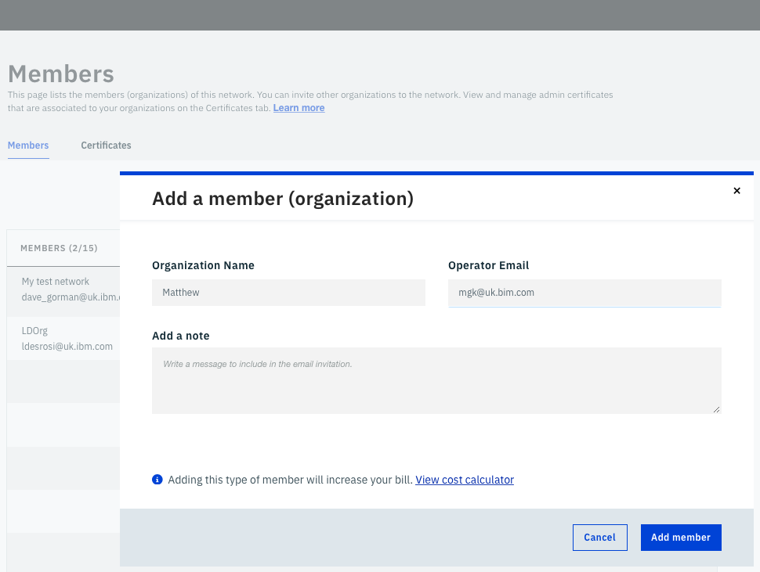
Notes – Org1 Creates The Network
After Org1 has initiated creation of the network on behalf of the other network members, they do not retain any special privileges
Each org operates only their set of CAs and Peers. Each org can view the logs of the orderer nodes, but have not operational or administrative control
Org1 sets the following for the network:
Network name
Database for world state
Govenance policies (by default all members can create channels, instantiate chaincode and invite other members)
Org1 invites other members to join the network

Slide 40
Network Creation (3/8) – Org2 Joins The Network
Org2 accepts the invitation and joins the new network
CA
CA
O
O
O
CA
E₁
E₂
CA
Org1
OrdererOrg
Org2
Member
IBM
Member
Network

Slide 41
Network Creation (4/8) – Additional Peers Created
If required, admins for each org can add additional peers
2 peers are recommended for high-availability
CA
E₀
E₃
CA
O
O
O
CA
E₁
E₂
CA
Org1
OrdererOrg
Org2
Member
IBM
Member
Network

Slide 42
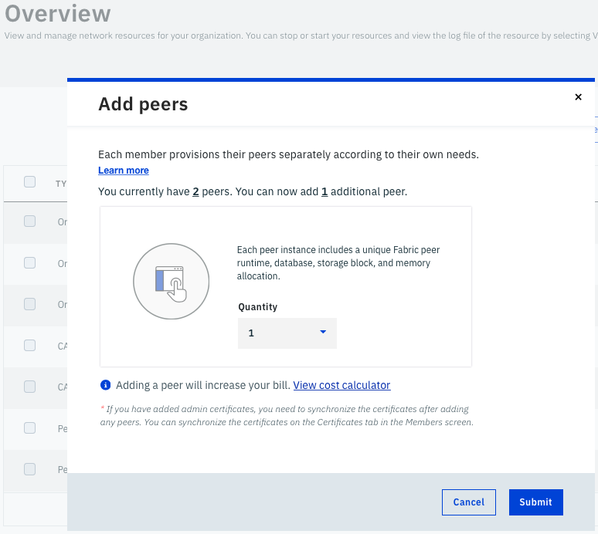
Notes – Additional Peers Created
Each Org decides how many peers they create
Admins create additional peers
At least 2 peers are recommended for high-availability, which is especially important during rolling-upgrades of the network
Not all peers need to connect to all channels

Slide 43
Network Creation (5/8) – Install Chaincode
Admins for each org install chaincode to peers in their org
CA
E₀
E₃
CA
O
Y
A
Z
B
O
O
CA
E₁
E₂
CA
A
Y
B
Z
Org1
OrdererOrg
Org2
Member
IBM
Member
Network

Slide 44
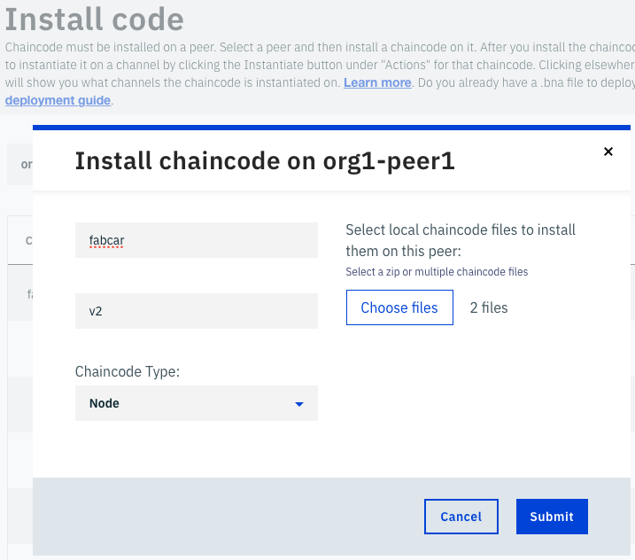
Notes – Install Chaincode
Admins for each org install chaincode to the peers in their org
Each chaincode is given a name and a version
Both Golang and Node.js chaincode are supported

Slide 45
Network Creation (6/8) – Create Channels
Channels are created by an admin in either org. A policy defines which orgs can join the channel
Other orgs receive notification of new channels and can accept or reject.
CA
E₀
E₃
CA
O
Y
A
Z
B
O
O
CA
E₁
E₂
CA
A
P
P
Y
B
Z
Org1
OrdererOrg
Org2
Member
IBM
Member
Network

Slide 46
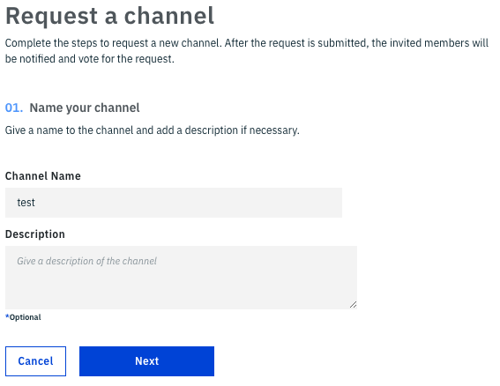
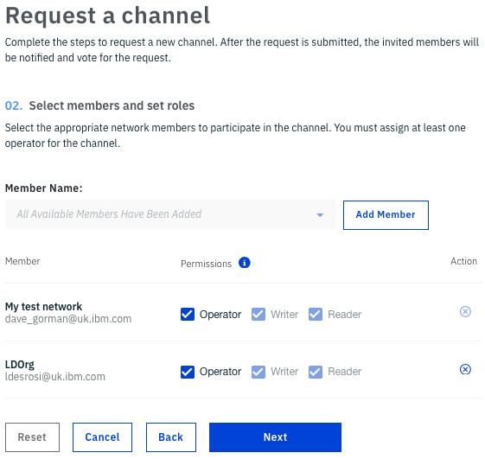
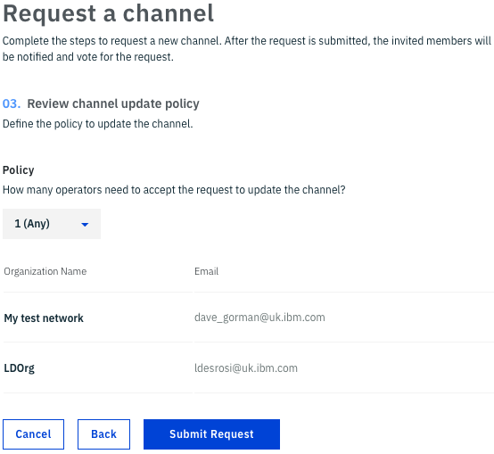
Notes – Create Channels
An admin creates a new channel.
Each channel has:
Name
Set of members (other orgs)
Roles defined for each member
Policy defining governance
All members receive a notification of the new channel and can accept/reject
Permissions are:
Reader – Query the channel
Writer – Query and Write to the channel
Operator – Read/Write and Update

Slide 47
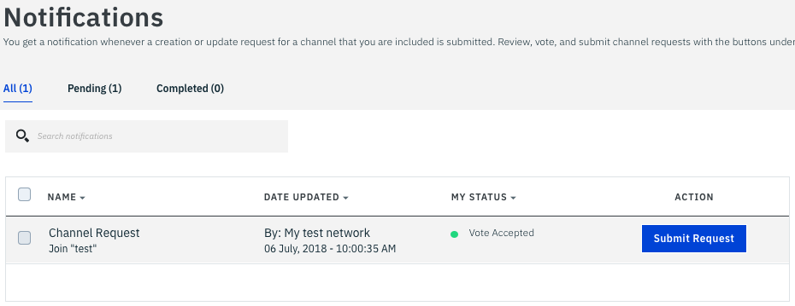
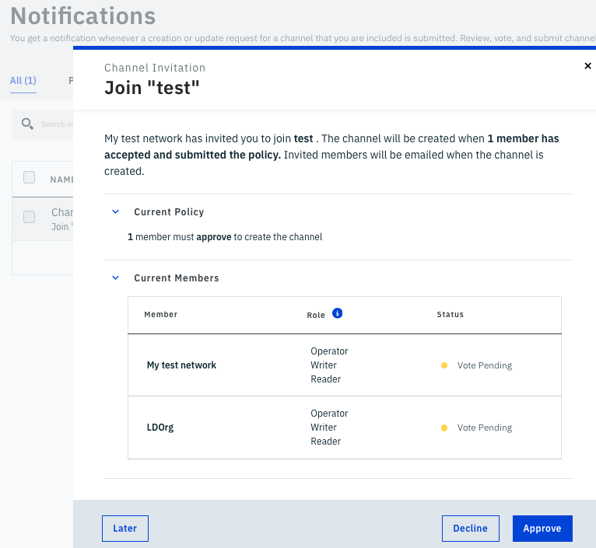
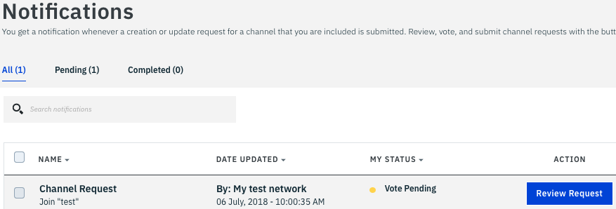
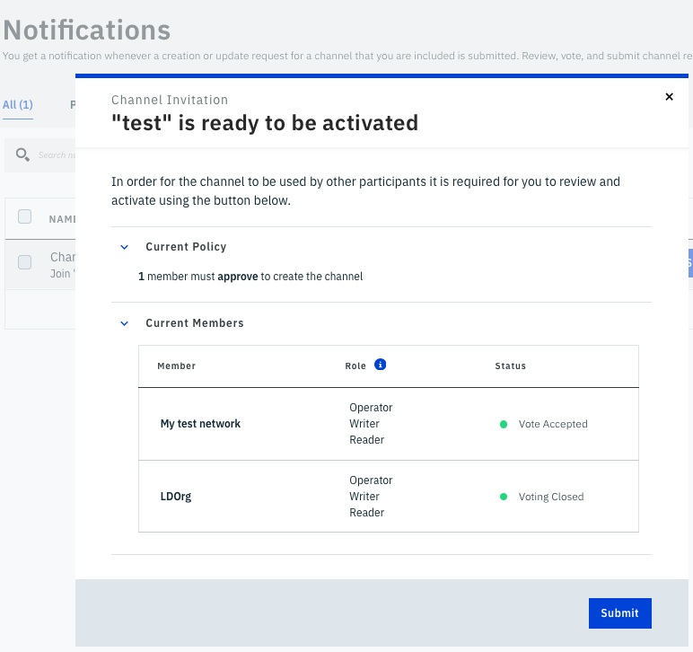
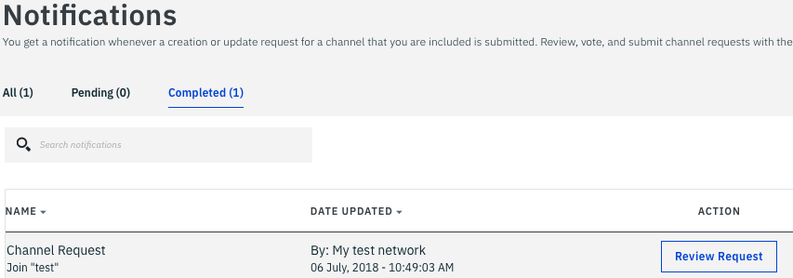
Notes – Create Channels
Each member organization receives notification of the new channel.
The admin can review, approve and submit their response to the notification
Once enough approvals have been received the new channel will be created

Slide 48
Network Creation (7/8) – Peers Join Channels
The admin in Org1 joins Peer E₀ to the red channel and E₁ to the blue channel
The admin in Org2 joins Peer E₂ to the red channel and E₃ to the blue channel
CA
E₀
E₃
CA
O
Y
A
Z
B
O
O
CA
E₁
E₂
CA
A
P
P
Y
B
Z
Org1
OrdererOrg
Org2
Member
IBM
Member
Network

Slide 49
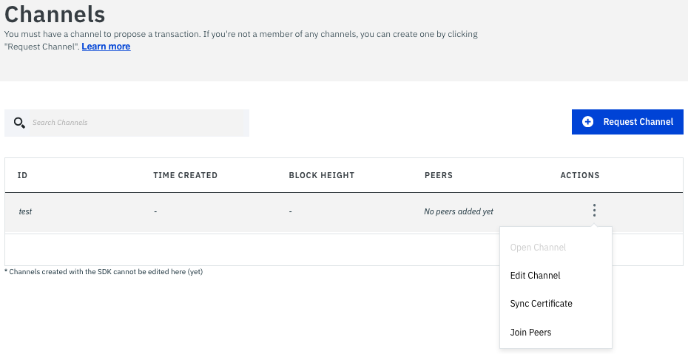
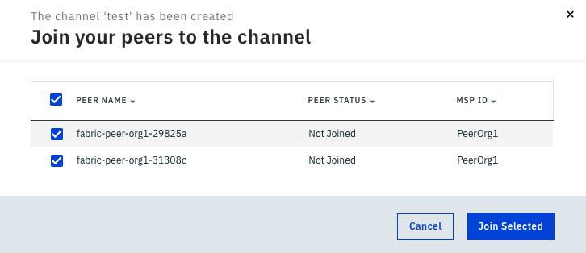
Notes – Peers Join Channels
The admin in each org selects ‘Join Peers’ within each channel, and then selects the peers

Slide 50
Network Creation (8/8) – Instantiate Chaincode
Chaincode is instantiated by an admin in either org
The policy defined in the channel identifies which admins are permissioned
CA
E₀
E₃
CA
O
Y
A
Z
B
O
O
CA
E₁
E₂
CA
A
P
P
Y
B
Z
Org1
OrdererOrg
Org2
Member
IBM
Member
Network

Slide 51
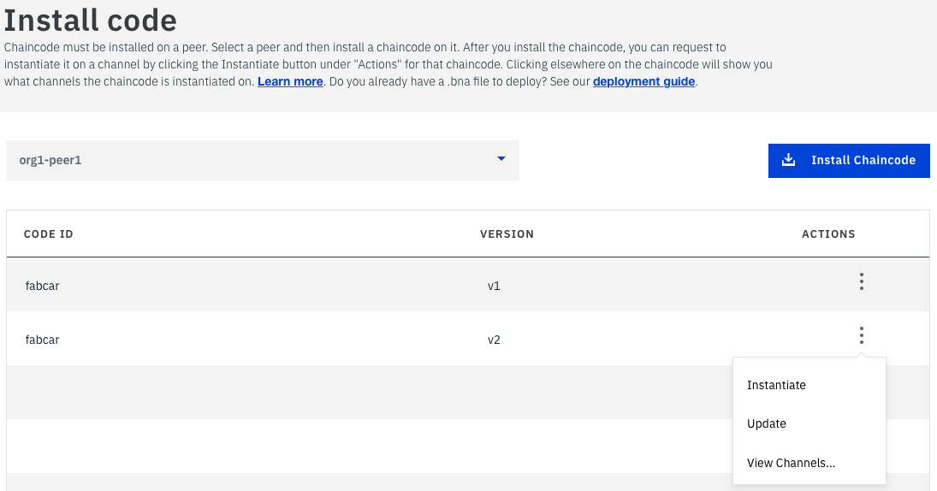
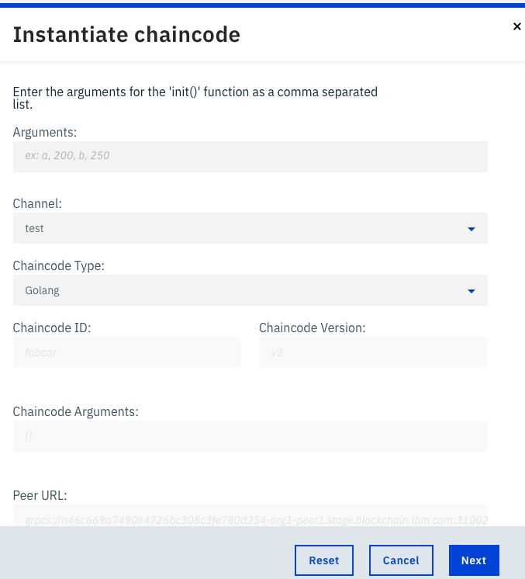
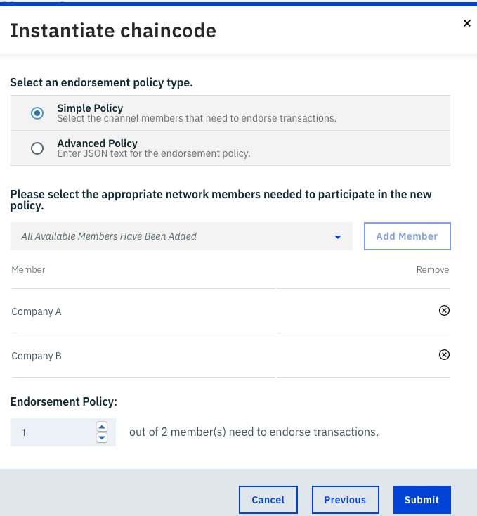
Notes – Instantiate Chaincode
An admin with operator permission on the channel can instantiate chaincode
Initial arguments for the chaincode are specified and an endorsement policy

Slide 52
Technical Deep Dive
Roadmap
Architectural Overview
Platform Components
Organization and Plans
Transaction Flow
Example Networks
Network Setup
[ Endorsement Policies ]
Identities and MSP

Slide 53
IBM Blockchain Platform - Endorsement Policies
An endorsement policy describes the conditions by which a transaction can be endorsed. A transaction can only be considered valid if it has been endorsed according to its policy.
Each chaincode is deployed with an Endorsement Policy
ESCC (Endorsement System ChainCode) signs the proposal response on the endorsing peer
VSCC (Validation System ChainCode) validates the endorsements
Endorsing Peer
Committing Peer
Chaincode
ESCC
VSCC
Ledger
Sign
Order - Deliver
Policy
Propose - Execute - Respond
P
Validate - Commit
Notes:
Examples on following slides.

Slide 54
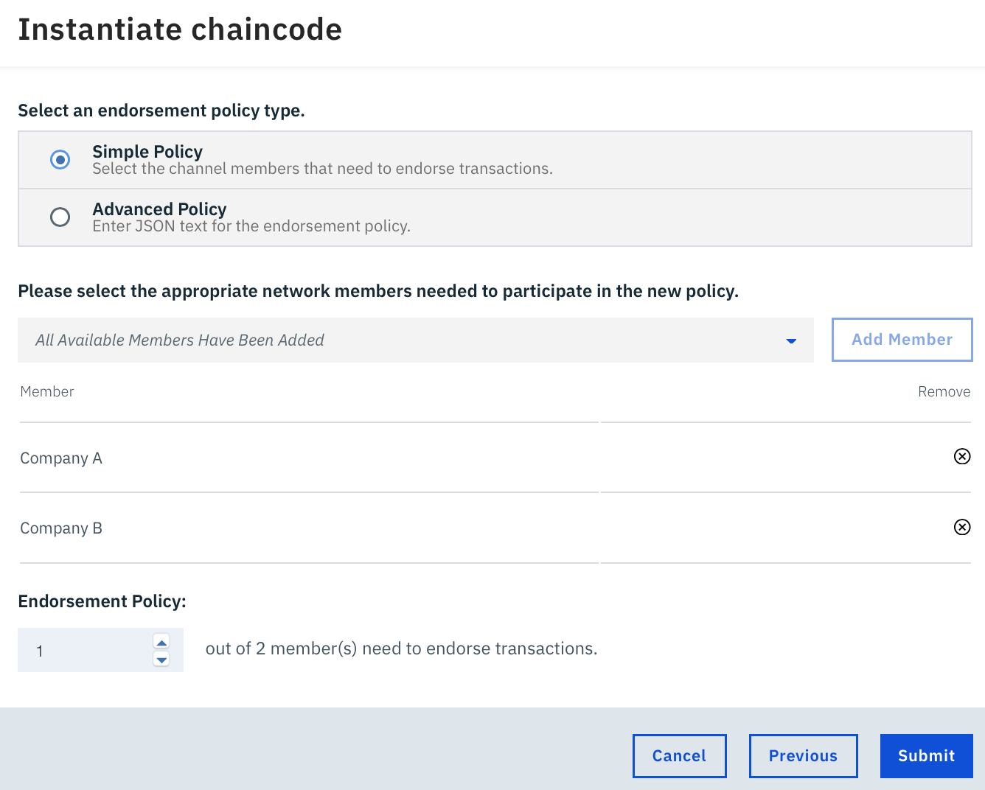
Endorsement Policy Examples
Endorsement policy is specified when instantiating a chaincode on a channel
Simple Policy:
Select which members of the channel must endorse a transaction for this chaincode
Specify how many members must endorse each transaction
Notes:
Polish notation is used to specify the policy.

Slide 55
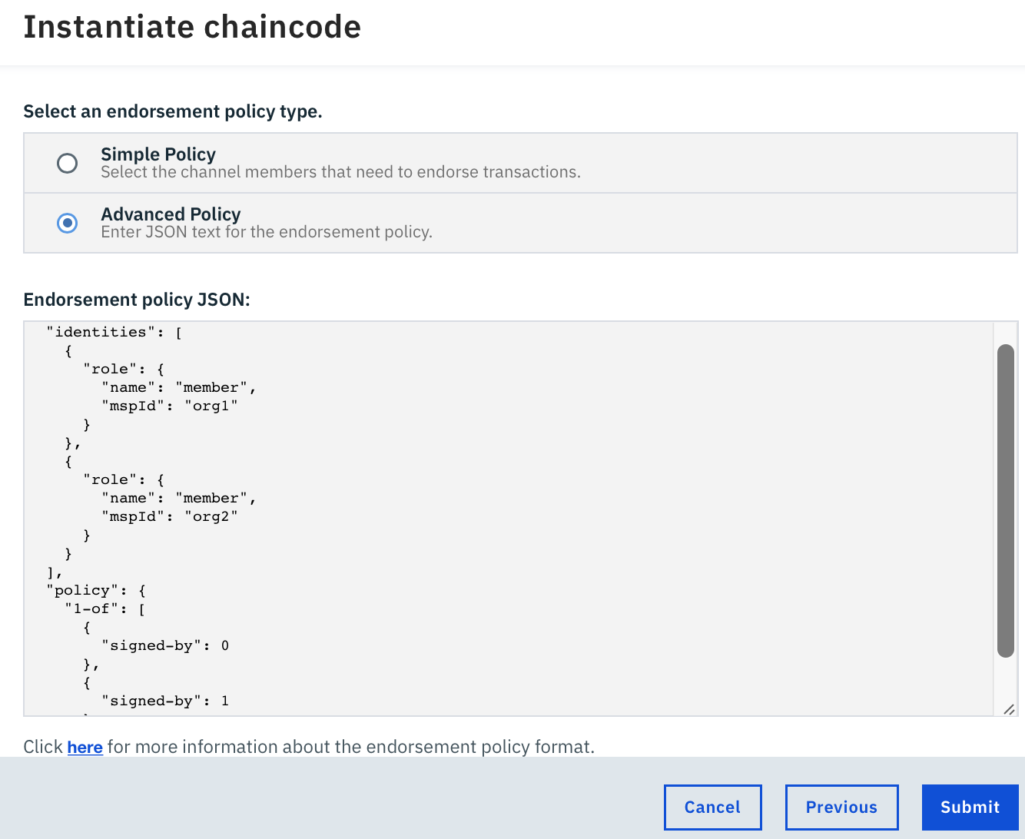
Endorsement Policy Examples
Alternatively specify an advanced policy in JSON syntax:
Role name can be ‘admin’ or ‘member’
Policy can include AND and OR logic
For example a policy can state that a transaction must be endorsed by Org1 and either Org2 or Org3.
For more information on policy syntax:
https://fabric-sdk-node.github.io/global.html#ChaincodeInstantiateUpgradeRequest
Notes:
Polish notation is used to specify the policy.

Slide 56
Endorsement Policy Examples
Examples of policies:
Signed by any member from one of the organizations
{
identities: [
{ role: { name: "member", mspId: "org1" }},
{ role: { name: "member", mspId: "org2" }}
],
policy: {
"1-of": [{ "signed-by": 0 }, { "signed-by": 1 }]
}
}
Signed by admin of the ordererOrg and any member from one of the peer organizations
{
identities: [
{ role: { name: "member", mspId: "peerOrg1" }},
{ role: { name: "member", mspId: "peerOrg2" }},
{ role: { name: "admin", mspId: "ordererOrg" }}
],
policy: {
"2-of": [
{ "signed-by": 2},
{ "1-of": [{ "signed-by": 0 }, { "signed-by": 1 }]}
]
}
}
AND
OR
Index of role in identities
Notes:
Polish notation is used to specify the policy.

Slide 57
Technical Deep Dive
Roadmap
Architectural Overview
Platform Components
Organization and Plans
Transaction Flow
Example Networks
Network Setup
Endorsement Policies
[ Identities and MSP ]

Slide 58
IBM Blockchain Platform - Membership Services Provider
A MSP manages a set of identities within a distributed network
Provides identity for:
Peers and Orderers
Client Applications
Administrators
Identities can be issued by:
Fabric-CA
An external CA
Provides: Authentication, Validation, Signing and Issuance
Supports different crypto standards with a pluggable interface
A network can include multiple MSPs (typically 1 per org)
Includes TLS crypto material for encrypted communications
HSM secures private keys for: Orderers, Peers and CAs(*)
O
E
User
Application
SDK
Channel
MSP
O
O
Local
MSP
Local
MSP
Admin
Local
MSP
Local
MSP
Ordering-Service
CA
Hardware Security Module
(*) Only Enterprise Plan has HSMs built-in

Slide 59












IBM Blockchain Platform - Certificate Architecture
An IBP network is comprised of multiple MSPs issuing identities
Enterprise Plan
Orderer certs issued by a network orderer root CA
Intermediate CA (iCA) certs are issued by a dedicated network root CA
Org iCAs issue certificates to: Peers, Users and Admins
Org1 Users
iCA
O
iCA
Orderer
Root CA
Key
Issuer | Cert
Org1
Admin
iCA
E₁
O
O
E₂
iCA
Org1
OrdererOrg
Org2
Remote CA
(optional for users and admins)
Member
IBM
Member
Network

Slide 60
Certificate Architecture - Explained
Orderer node Ecerts
Issued by a hidden Orderer Root CA running Fabric-CA
One Orderer Root CA per Enterprise Plan network
Organisation intermediate CA certs
Each organisation has a pair of CAs for High Availability (logically 1 CA)
Issued by a hidden Network Root CA running Fabric-CA
One Network Root CA per Enterprise Plan network
Peer Ecerts
Issued by the org iCA
Users and Admins Ecerts
Typically issued by the org iCA
Optionally issued by remote CAs
Requires channel MSP configuration changes

Slide 61

IBM Blockchain Platform - TLS Architecture
Both Enterprise and Starter Plans have all communications secured by TLS
Blockchain Platform
Includes: client-peer, client-orderer, orderer-peer
Common TLS server certificates are issued by Digicert
Optional Mutual TLS support on Enterprise Plan
iCA
O
iCA
iCA
E₁
O
O
E₂
iCA
Digicert
Org1
OrdererOrg
Org2
Initiator
IBM
Member
Network

Slide 62
TLS Architecture - Explained
TLS Server certs can be downloaded from here:
Starter Plan US:
http://blockchain-certs.mybluemix.net/us01.blockchain.ibm.com.cert
http://blockchain-certs.mybluemix.net/us02.blockchain.ibm.com.cert
Starter Plan UK:
http://blockchain-certs.mybluemix.net/uk01.blockchain.ibm.com.cert
http://blockchain-certs.mybluemix.net/uk02.blockchain.ibm.com.cert
Starter Plan Sydney:
http://blockchain-certs.mybluemix.net/aus01.blockchain.ibm.com.cert
http://blockchain-certs.mybluemix.net/aus02.blockchain.ibm.com.cert
Enterprise Plan:
https://blockchain-certs.mybluemix.net/3.secure.blockchain.ibm.com.rootcert
Application and commands must be configured with TLS server certificates to enable communication to the peers and orderers
Enterprise Plan network initiator can choose to enable Mutual TLS. Additional CA per org issues client TLS certificates.
TLS private keys are secured in Secure Service Containers on Enterprise Plan, not the HSM.

Slide 63
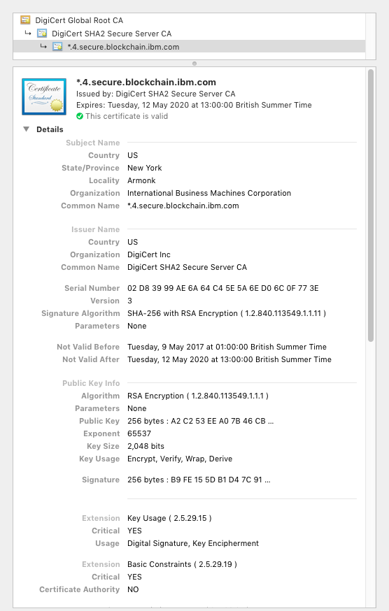
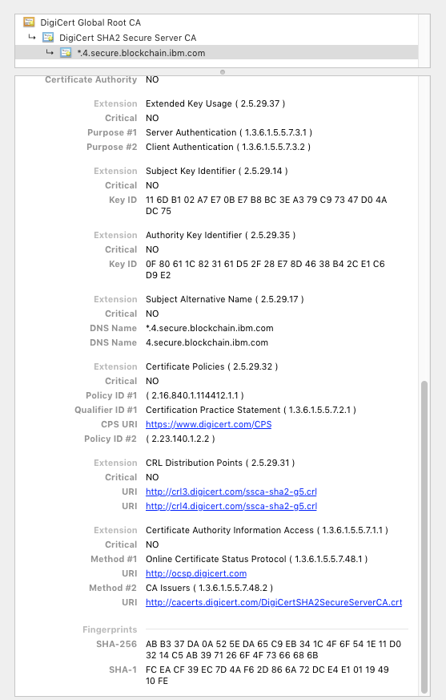
Enterprise Plan Server TLS Certificate - Example
Issued by intermediate DigiCert CA and backed by the root DigiCert CA
Includes a wildcard CN (see example)

Slide 64
IBM Blockchain Platform - Hardware Security Module (HSM)
Enterprise Plan Networks are backed by an HSM
FIPS 140-2 Level 4 compliant (highest level)
Secure Service Containers are signed by key in HSM
See Crypto5S for more info
https://www-03.ibm.com/security/cryptocards/pciecc2/overview.shtml
https://www-03.ibm.com/security/cryptocards/hsms.shtml
Issues and secures private keys for:
Peers
Orderers
CAs
E
CA
O
Hardware Security Module

Slide 65
IBM Blockchain Platform - User Identities
Each client application has a local MSP to store user identities
Each local MSP includes:
Keystore
Private key for signing transactions
Signcert
Public x.509 certificate linked to Private key
May also include TLS credentials
Can be backed by a Hardware Security Module (HSM)
Issued by CA server within each IBP organisation
Client
Application
SDK
Local
MSP
user@org1.example.com
keystore | <private key>
signcert | user@org1.example.com-cert.pem

Slide 66
IBM Blockchain Platform - Admin Identities
Each Administrator has a local MSP to store their identity
Each local MSP includes:
Keystore
Private key for signing transactions
Signcert
Public x.509 certificate linked to Private key
May also include TLS credentials
Can be backed by a Hardware Security Module (HSM)
Issued by CA server within each IBP organisation
Admin
Local
MSP
admin@org1.example.com
keystore | <private key>
signcert | admin@org1.example.com-cert.pem

Slide 67
IBM Blockchain Platform - Peer and Orderer Identities
Each peer and orderer has a local MSP
Each local MSP includes:
keystore
Private key for signing transactions
signcert
Public x.509 certificate linked to Private key
In addition Peer/Orderer MSPs identify authorized administrators:
admincerts
List of administrator certificates
cacerts
The CA public cert for verification
crls
List of revoked certificates
Peers and Orderers also receive channel MSP info
Secured by the HSM in Enterprise Plan
P
O
Local
MSP
Local
MSP
peer@org1.example.com
admincerts | admin@org1.example.com-cert.pem
cacerts | ca.org1.example.com-cert.pem
keystore | <private key>
signcert | peer@org1.example.com-cert.pem
crls | <list of revoked admin certificates>

Slide 68
IBM Blockchain Platform - Channel MSP information
Channels include additional organisational MSP information
Determines which orderers or peers can join the channel
Determines client applications read or write access to the channel
Stored in configuration blocks in the ledger
Each channel MSP includes:
admincerts
Any public certificates for administrators
cacerts
The CA public certificate for this MSP
crls
List of revoked certificates
Does not include any private keys for identity
Channel
MSP
Channel
MSP
Channel
MSP
Channels
ID = MSP1
admincerts | admin.org1.example.com-cert.pem
cacerts | ca.org1.example.com-cert.pem
crls | <list of revoked admin certificates>

Slide 69

IBM Blockchain Platform - User Registration and Enrollment
fabric-ca-client
Admin
O
Registration and Enrollment
Admin registers new user with Enroll ID
Using the SDK the user generates pub/private key pair and enrolls via a CSR with the CA to retrieve Ecert credentials
Additional offline registration and enrollment options available
1. Register(Enroll ID)
returns( secret)
2. Send Enroll ID and secret
3. Enroll(Enroll ID, secret)
Client
Application
User
returns Ecert
SDK
U
Local
MSP
CA

Slide 70
IBM Blockchain Platform - Transaction Signing
All transactions within an IBM Blockchain Platform network are signed by the sender and validated by the recipient
Senders sign transactions with their enrolment private key
Stored in their local MSP
Receivers ßvalidate transactions and certificates
Root CA certificates and CRLs stored in local MSP
Root CA certificates and CRLs stored in Org MSP in channel
4) Validate endorser signature
2) Validate client signature
P
Client
Application
SDK
1) Sign proposal
8) Validate all signatures in delivery
3) Sign response
5) Sign order
O
7) Sign delivery
6) Validate client signature

Slide 71
Thank you
www.ibm.com/blockchain
developer.ibm.com/blockchain
www.hyperledger.org
© Copyright IBM Corporation 2017. All rights reserved. The information contained in these materials is provided for informational purposes only, and is provided AS IS without warranty of any kind, express or implied. Any statement of direction represents IBM's current intent, is subject to change or withdrawal, and represents only goals and objectives. IBM, the IBM logo, and other IBM products and services are trademarks of the International Business Machines Corporation, in the United States, other countries or both. Other company, product, or service names may be trademarks or service marks of others.

